Slide 1
CINTRA The Oracle Architects
Abdul Sheikh, CTO
Simon Rice, VP Enterprise Services
Kyle Smith, VP Client Services
Evolve to the Hybrid Enterprise Cloud
Driving business value and removing IT barriers!

Slide 2

The Cintra Difference
Optimized Architecture Solutions
Operational Excellence for Highest SLAs
Cost and Agility Focus
Blueprinted Risk Mitigated Delivery
Transforming businesses with architecture solutions for availability, performance, agility, operational excellence and highest service levels.
Notes:
Headings needed on pillars

Slide 3

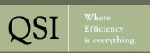

















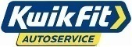





















We are trusted by our clients globally
Notes:
Engineered Systems
Exadata
Exalogic
Supercluster
Software
WebLogic Suite (WebLogic Server, Coherence)
Associated management components
WLS Management Pack
Cloud Management Pack
Coherence Management Pack
Delivered
Easily allowing customers becomes an internal service provider
Minimizing both CapEx and OpEx equation
Infrastructure Services
Compute
Storage
Platform Services
Database Cloud Service
Java Cloud Service
Delivered
Subscription model
Eliminating CapEx Expense

Slide 4
We have to evolve in the competitive landscape
IT organizations are being challenged to provide greater performance, agility and availability capabilities over a growing data set with ever-tighter IT budgets
Shrinking IT Budgets
Tighter Regulatory Compliance
Assured Service Levels
Exponential Data Growth
IT organizations can no longer ignore the need to adopt agile approaches to technology across the board, from converged systems and cloud, to virtualization and automation. Organizations must transform to compete in the digital economy.
Notes:
This might be a better view

Slide 5
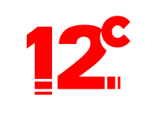
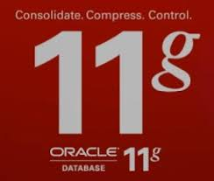
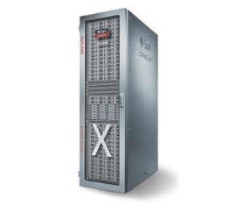
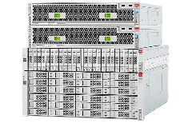
Optimal Cloud Strategy – Public Cloud and Private Cloud
HYBRID ENTERPRISE CLOUD
YOUR CLOUD
ORACLE CLOUD
Same Products
Same Architectures
Same Standards
Same Best Practices
Private Cloud
Public Cloud
Portability and Agility from On-Premises to Cloud and Back!
Notes:
Engineered Systems
Exadata
Exalogic
Supercluster
Software
WebLogic Suite (WebLogic Server, Coherence)
Associated management components
WLS Management Pack
Cloud Management Pack
Coherence Management Pack
Delivered
Easily allowing customers becomes an internal service provider
Minimizing both CapEx and OpEx equation
Infrastructure Services
Compute
Storage
Platform Services
Database Cloud Service
Java Cloud Service
Delivered
Subscription model
Eliminating CapEx Expense

Slide 6
How Evolved is your Architecture ?

Slide 7

How Evolved is your Architecture ?
We need an honest assessment of our current architecture
Does our current architecture fill you with confidence in meeting your business requirements?
Architecture | Legacy Capability | Modern Capability | HA | CONSOLIDATE | APPLIANCE | ORACLE VERSIONS | MANAGE | REPORT | SECURE | CLONE | OPTIMIZE LICENSE
User Experience | 4 | 8 |  |  | ü | ü | ü | ü
Job Performance | 4 | 9 |  |  | ü | ü | ü | ü
Availability | 4 | 9 | ü | ü | ü | ü | ü | ü | ü | ü
Data Protection | 2 | 8 | ü | ü | ü | ü | ü | ü | ü | ü
Time to Recover | 4 | 8 | ü | ü | ü | ü | ü | ü | ü | ü
Agility | 2 | 9 |  | ü | ü | ü | ü | ü |  | ü | ü
Scalability | 3 | 7 | ü | ü | ü | ü | ü | ü |  |  | ü
Security | 2 | 8 |  | ü |  | ü |  |  | ü
Simplicity | 4 | 8 | ü | ü | ü | ü |  | ü |  | ü
Data Management | 1 | 6 |  |  | ü | ü | ü | ü | ü
Productivity | 3 | 7 | ü | ü | ü | ü | ü | ü |  | ü
SW Compliance | 3 | 8 | ü | ü | ü | ü |  |  |  |  | ü
Business Value | 3 | 8 | ü | ü | ü | ü | ü | ü | ü | ü | ü

Slide 8


Wait… It’s not all doom and gloom!
The Chinese word for “Crisis” is made up of:
“Danger”
“Opportunity”
How often in our careers do we have the opportunity to completely assess and reinvent our IT estate, for the good of our business?
This should be every CIO’s dream – let’s grasp the opportunity and truly transform our IT!

Slide 9
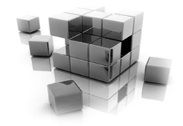
This is not a Pure Cloud conversation…
Cloud is just one piece of the puzzle
A holistic architecture view is required
Modernize your local on-premise architecture
On-premise and cloud strategies to be aligned
Business requirements need to be analyzed: What is appropriate for on-premise and what is appropriate for off-premise?
……..… This is an Architecture conversation
Notes:
Engineered Systems
Exadata
Exalogic
Supercluster
Software
WebLogic Suite (WebLogic Server, Coherence)
Associated management components
WLS Management Pack
Cloud Management Pack
Coherence Management Pack
Delivered
Easily allowing customers becomes an internal service provider
Minimizing both CapEx and OpEx equation
Infrastructure Services
Compute
Storage
Platform Services
Database Cloud Service
Java Cloud Service
Delivered
Subscription model
Eliminating CapEx Expense

Slide 10



The Promise of Cloud Computing
IT Development, Operations And Line of Business Want …
Developers
Agility & Quality
IT Operations
Performance & Costs
Line of Business
Innovation & Speed
Latest Technology
Instant Access
Better Code
Frequent Releases
Build Once Deploy Anywhere
Faster Response
Higher QoS
Lower Risk
Lower Costs
Do More with Less
New Markets
New Products
Richer Insights
Ubiquitous Access
Ease of Use

Slide 11

Cloud Architecture Strategies:
Considerations for Private Cloud Design

Slide 12

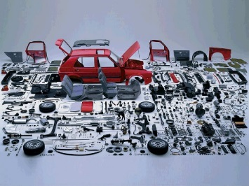

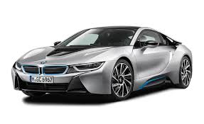
Ask yourself what business are you in ? Let’s get on with our real business !
Traditional Approach
Do it yourself and third-party tools
Installation and Management
Complexity
Long Timelines
Manual Integration
Compromised Configuration
Staff focused on troubleshooting and making it all work
Converged Approach
✓
✓
✓
✓
One point of accountability
Engineered to work together
Tested & proven architecture
Staff focused on strategic projects
Notes:
Main Talking Points:
The phrase “Storage Solutions” means many different things to many different people. Because we own the full stack, at Oracle, we base our storage solutions on optimization and testing done during the complete product development cycle.
- We do real world workload testing on individual components as well as across the full stack.
- As such the Oracle Sun ZFS Storage Appliance with Oracle Snap Mgr Utility is a single, engineered and pre-integrated IT solution for data protection of mission critical Oracle Databases.
Through high-performance systems engineering, Oracle delivers the best applications-to-disk environment by integrating its software, server, storage, and networking technologies to deliver some of the most scalable, reliable, and secure products available today. With the full software and hardware portfolio at its disposal, only Oracle designs and integrates everything from the semiconductor chip to the entire software stack to achieve performance levels that are unmatched in the industry. This tight integration between Oracle’s hardware and software improves system performance and provides better ways to access and manage information, all at a lower total cost of ownership. And because Oracle systems are built on open standards, they can be deployed in the datacenter as individual components, or as solutions that are integrated from applications to disk.
Integration is driven by Organizational Alignment
Common Goals and Priorities are shared by the Teams
Direct Collaboration of Engineering Teams enables Greater Ability to Share Core IP across products
No NDA, No Attorneys, No Law Firms
No Intermediate contacts, No Alliance Managers
Organizational Alignment enables Faster Innovation and Integration
Optimization across the Full Stack
Optimization from Applications down to underlying Hardware
We make sure that Software takes full advantage of unique features in Oracle Hardware (ILOM, SSD, ARC, L2ARC) while leveraging open standards and fully supporting other vendors
Oracle is the one single vendor that can do all that
In particular, the Oracle Snap Manager Utility uniquely takes advantage of Sun ZFS Storage Appliance features such Snaps, Clones, Replication, integrated interface to Oracle Database, DataGuard delivering dramatically improved results.
Synchronization Hardware and Software Release Schedules
No compatibility issues during deployment
Patches and Updates will not break Customer Deployments
As such, since the entire IT architecture is engineered to work together, administration and maintenance is also engineered to minimize risk and enhance system maintenance procedures.
.

Slide 13
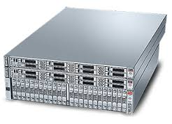
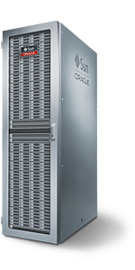
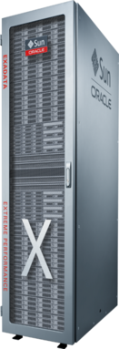
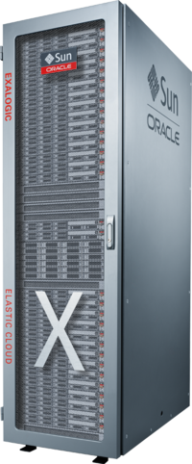
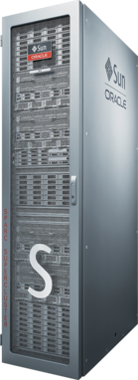
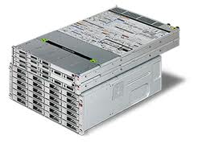
Engineered Systems Proven and Adopted Engineered Systems are the platform of the digital age
Database Appliance
Exadata
Database Machine
Exalogic
Elastic Cloud
Private Cloud Appliance
SPARC
SuperCluster
ZFS Storage Appliance
Expedited time to market
Easier to manage and upgrade
Lower cost of ownership
Reduced change management risk
Better reliability and one-stop support
Extreme performance
Notes:
Engineered Systems
Exadata
Exalogic
Supercluster
Software
WebLogic Suite (WebLogic Server, Coherence)
Associated management components
WLS Management Pack
Cloud Management Pack
Coherence Management Pack
Delivered
Easily allowing customers becomes an internal service provider
Minimizing both CapEx and OpEx equation
Infrastructure Services
Compute
Storage
Platform Services
Database Cloud Service
Java Cloud Service
Delivered
Subscription model
Eliminating CapEx Expense

Slide 14
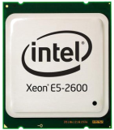
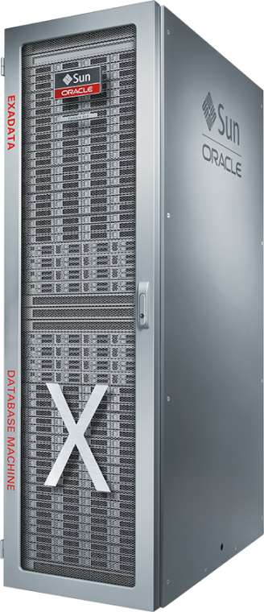

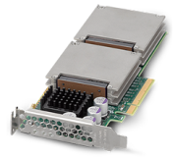
Exadata: Purpose-Built for the Oracle Database
Unique Software Algorithms Optimize Database Processing
Database offload in storage
Data intensive query operations offloaded to storage CPUs
100 GB/sec SQL data throughput
Database optimized storage
Hybrid Columnar 10x Compression for read-intensive and archive data
Database optimized PCI Flash
Smart caching of database data
Smart algorithm for log writes
Database optimized QoS
End-to-end prioritization from app to DB, network, and storage
Database optimized availability
Fast detection and recovery of failed server, storage or switch
Exachk validation of hardware, settings, software, best practices
Database optimized messaging
Custom InfiniBand protocol for low latency, high throughput SQL

Slide 15
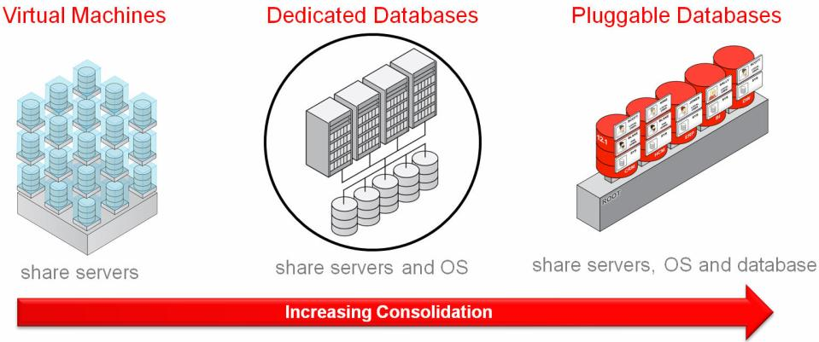
Confident Architecture Consolidation
Reaping the maximum benefits from private cloud architecture strategy
Consolidation Benefits
Greater value from our existing hardware and software investments
All databases within a tier benefit from all licensable software options installed
Giving us greater availability, security, compression, etc
Greater agility and automation (e.g. Test/Dev cloning, patching, DR)
Notes:
Engineered Systems
Exadata
Exalogic
Supercluster
Software
WebLogic Suite (WebLogic Server, Coherence)
Associated management components
WLS Management Pack
Cloud Management Pack
Coherence Management Pack
Delivered
Easily allowing customers becomes an internal service provider
Minimizing both CapEx and OpEx equation
Infrastructure Services
Compute
Storage
Platform Services
Database Cloud Service
Java Cloud Service
Delivered
Subscription model
Eliminating CapEx Expense

Slide 16
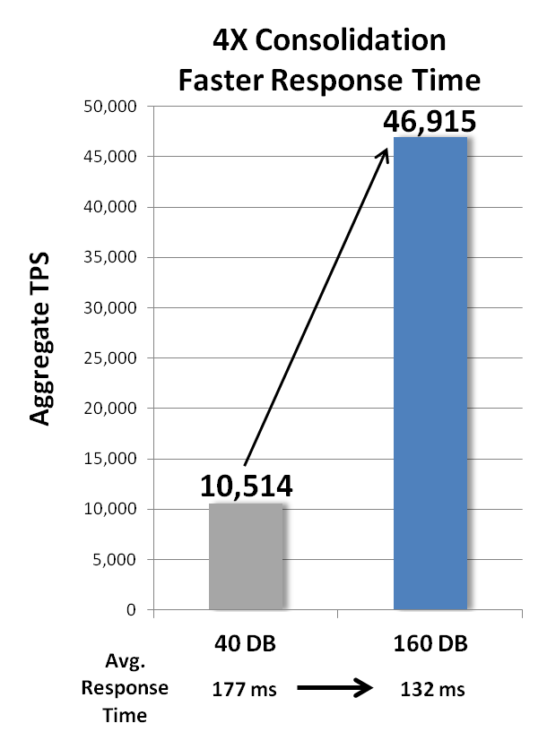
Exadata : 4X Consolidation Density
Challenge: How many more databases can be consolidated on Exadata, compared to a fast x86 system?
Approach: Compare the same Exadata system, with and without Exadata features* enabled, increasing databases until saturation.
Results: 160 databases (CPU-bound) on Exadata, compared to 40 databases (I/O-bound) on equivalent x86 hardware. Exadata consolidates 4X as many databases with faster transaction response times.
Exadata X4-2
x86
*Includes Exadata Smart Flash Logging, Smart Flash Cache, Smart Scan, Smart Flash Cache compression, Storage Indexes, Network RM, IORM
Notes:
Soundbite:
As a consolidation platform for OLTP databases, Exadata can consolidate 2X to 5X more databases than a very fast (non-Exadata) x86 platform (same type and number of CPUs, disks and memory). Shown here is a 4X consolidation density comparison and faster average response times for Exadata.
------------------------------------------------------------------------------------
Explanation:
This slide shows the results of internal testing to measure the impact of Exadata-unique features on database consolidation density and response times. It is intended to respond to customer assertions that it is more cost-effective to use a less-expensive x86 system for database consolidation than Exadata. A 4X consolidation density advantage for Exadata means that a customer would need to purchase 4X more non-Exadata x86 hardware to achieve the same consolidation as Exadata. Also, if they don’t already own the software licenses, a 4X increase in the CPUs would be a huge additional expense that would dwarf the cost of hardware.
The approach used an Exadata X4-2 full-rack system for both “bars” in the graph. The number of databases consolidated was increased until a system bottleneck was reached. The bar labeled “x86” is an approximation of a very fast x86 system – it is in fact the Exadata system with many of the Exadata features (shown in the asterisked line) disabled. Note that IB cannot be disabled, nor can the optimized drivers and scale-out architecture. In other words, if this were truly comparing Exadata to a commodity x86 system, the Exadata advantage would be even greater.
In this test, both measurements have reached a bottleneck in the system. In the case of the “x86” system, I/O is the bottleneck. In the case of Exadata, CPU is the bottleneck. A more over-subscribed test (not shown) achieved 200 consolidated databases (5X consolidation density), but with a higher average response time than the “x86” test.
This slide shows a 4x consolidation density, with even faster average response times for Exadata. Since not all OLTP workloads are the same and customers may choose to undersubscribe system resources to allow for headroom, a 2X consolidation density is a safe and very conservative comparison. At 4X consolidation density, the Exadata system was stable, though adding more databases increased the average txn response time.
All OLTP workloads use Oracle’s Swingbench tool.

Slide 17
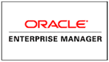
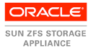
Oracle Technologies Enabling Your Private Cloud Journey
Oracle Database 12c
Multitenancy: Greater consolidation, faster provisioning, easier management
Automatic Data Optimization: Smart compression and automatic data tiering
Oracle Enterprise Manager 12c
Single view of on-premise and public cloud services
Chargeback and Showback modules for cloud management
Automation and provisioning tools for private and public clouds
Exadata Database Machine
Run Oracle Database on Oracle Hardware
Optimized for database workload and extreme uptime
ZFS Storage Appliance
Fastest backup and recovery solution for Oracle databases
Snapshot capabilities for point-in-time views and Non-Prod cloning
ILM Data Management including HCC compression of archive data
Notes:
Engineered Systems
Exadata
Exalogic
Supercluster
Software
WebLogic Suite (WebLogic Server, Coherence)
Associated management components
WLS Management Pack
Cloud Management Pack
Coherence Management Pack
Delivered
Easily allowing customers becomes an internal service provider
Minimizing both CapEx and OpEx equation
Infrastructure Services
Compute
Storage
Platform Services
Database Cloud Service
Java Cloud Service
Delivered
Subscription model
Eliminating CapEx Expense

Slide 18
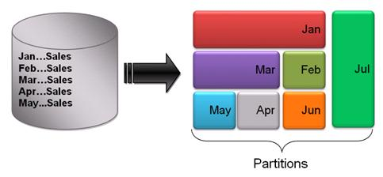
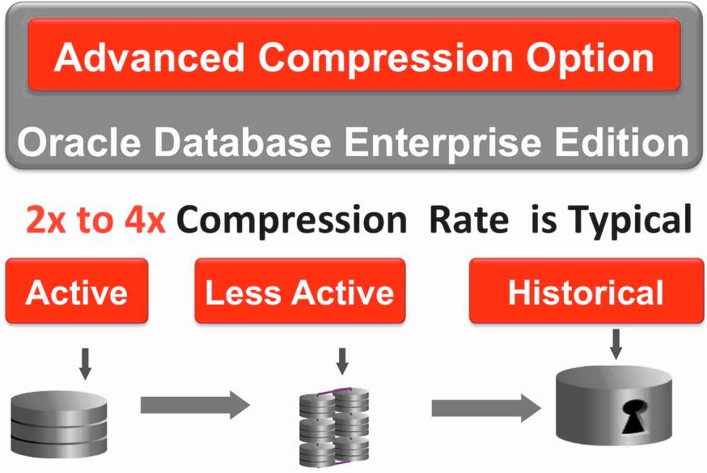
Data Management and Information Lifecycle Management
Oracle Partitioning
Segregate data based on query predicated
Less data read from storage
Ensure performance as data volumes grow
Flexibility to store partitions in dedicated tablespaces
Oracle Advanced Compression
Compress older partitions using varying degrees of compression as data becomes more static
Data remains compressed on disk and in memory
Additional benefits for backups and Data Guard
ZFS Storage Appliance bonus benefits
Compress data using Advanced Compression and Hybrid Columnar Compression for massive space savings (20x to 40x)

Slide 19

Information Lifecycle Management: Relational + Big Data
ILM Strategy
Store only your most active data on your prime real estate
Move older / static / less critical data to lower tier solutions
Move unstructured data (XML feeds, social media, images, video) to Hadoop clusters
Data Retention
Big Data structures allow for longer data retention periods, meeting regulatory needs at a more reasonable cost
Rather than losing data that may not have an immediate use, store it in a Big Data repository for later analysis

Slide 20
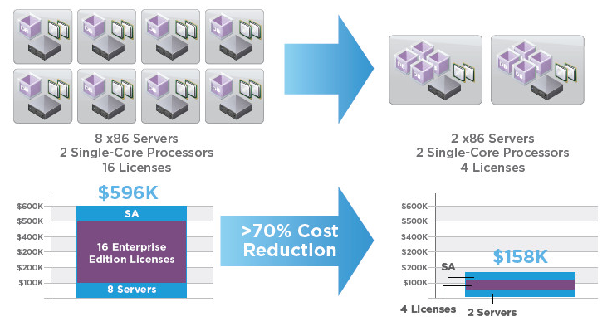
Software Costs: Consolidation optimizes licensing footprint
Lower license footprint = more affordable database options
All databases on the consolidated architecture benefit from these options

Slide 21
Software Costs: Reducing Your Footprint with CoD Models
Option 1: Build Your Own
License 72 Cores for Anticipated Growth
Option 2: Buy Database Appliance
License as You Grow and Save Significantly
48 Cores
32 Cores
Capacity When You Need It
24 Cores
OR
16 Cores
12 Cores
8 Cores
4 Cores
Year 1
Year 2
Year 3
Year 1
Year 2
Year 3
Pay It All Now
Pay As You Grow

Slide 22
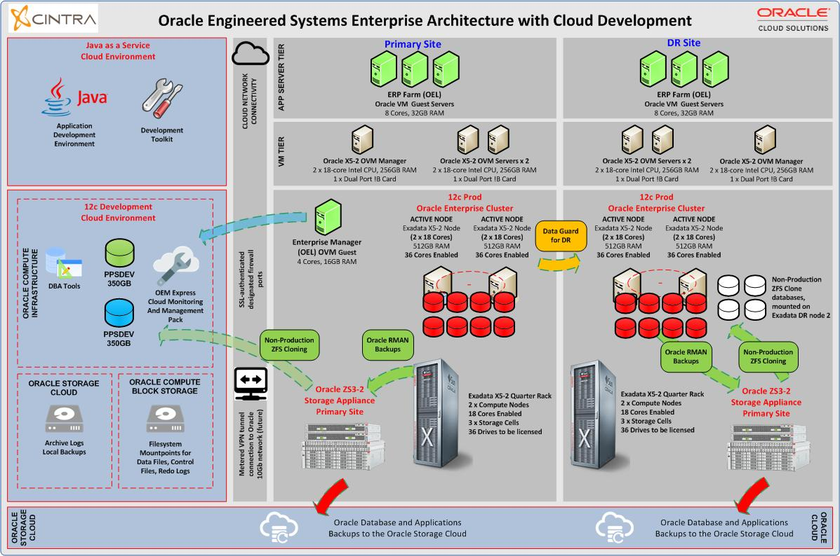


The Oracle Cloud

Slide 23
Cloud Architecture Strategies:
Now that you have your house in order…
Let’s talk Public Cloud!

Slide 24
Cloud Offerings: An Overview
SaaS
Deployed Applications
(CRM, ERP, ECM, etc.)
All Layers Support
Multi-Tenancy
Charge/Show Back
Scale Up & Down
Self-Service
Security & SSO
Service Reliability
Administration
Configuration Mgmt
Monitoring & Alerts
Analytics & Reporting
Application Framework
PaaS
Runtime
Web & Application Server
Database
Integration
Operating System
Compute
IaaS
Storage

Slide 25



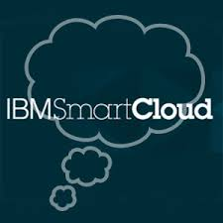
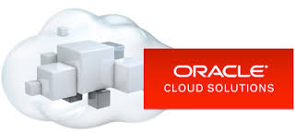
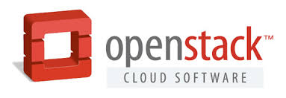
Cloud Offerings: Picking the Right Provider For Your Business

Slide 26
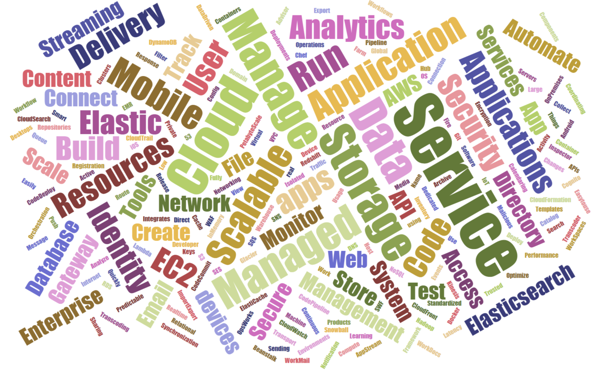
Cloud Offerings: Which Services Are Right For You?

Slide 27
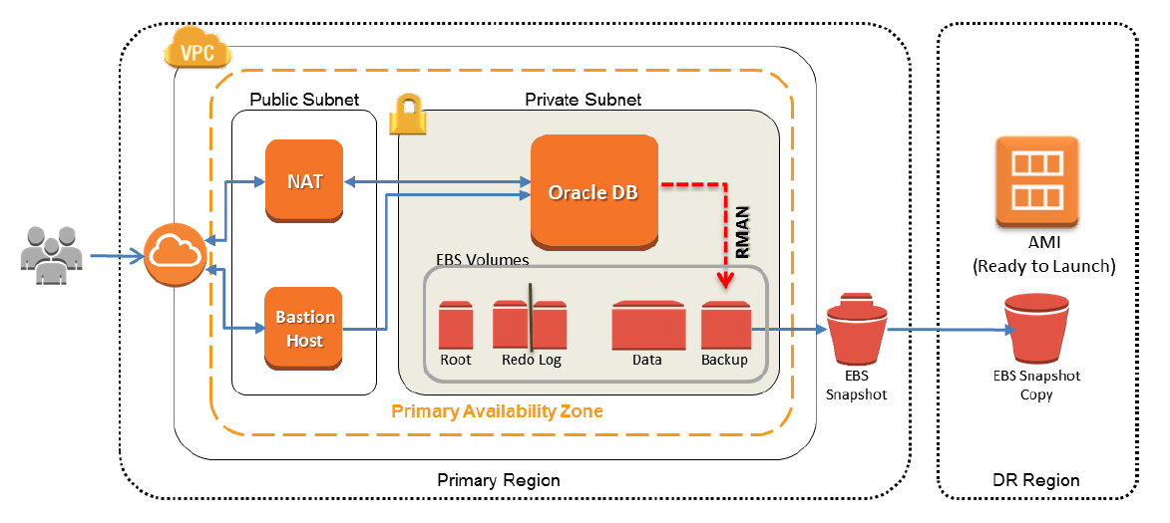
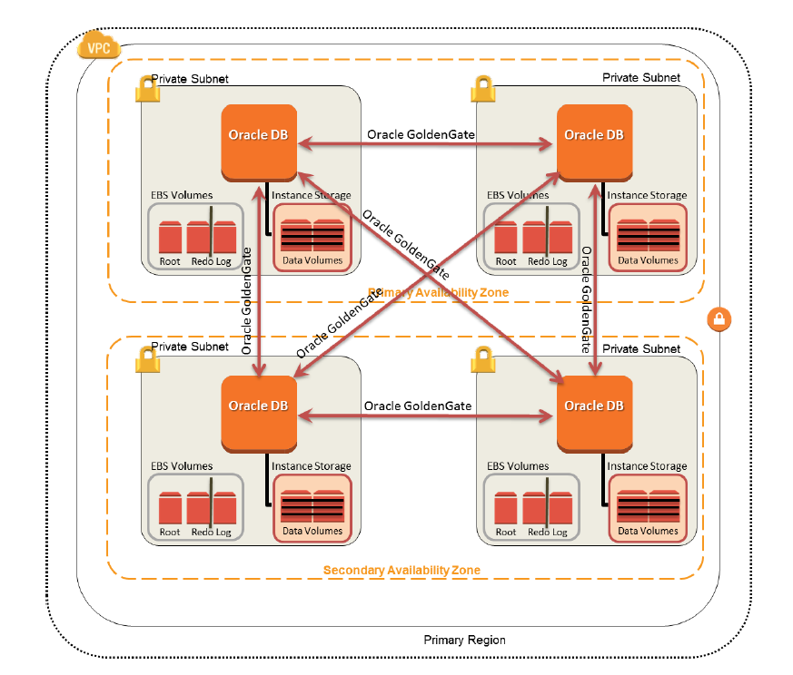
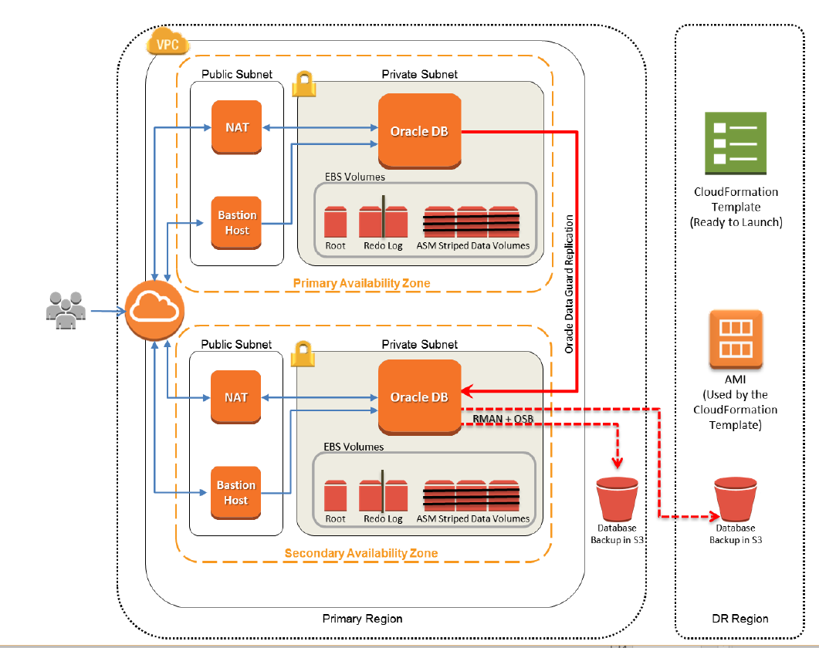
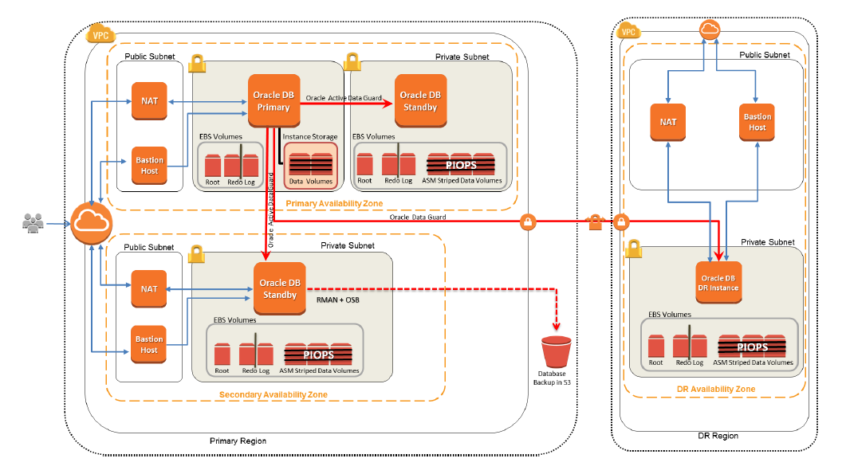
Cloud Offerings: Selecting the Right Architecture
AWS Oracle RAC Alternative Architecture

Slide 28
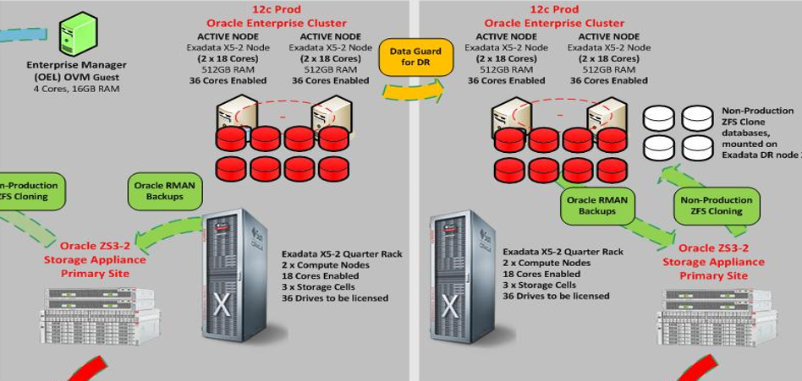
Cloud Design Golden Rule: Mirror Your On-Premise Architecture
Bake the same best practices into your Public Cloud architecture
High Availability
Agility, cloning and provisioning
Performance capabilities
Data archival capabilities

Slide 29



Oracle Database Offerings on PaaS & IaaS
Database Cloud Service
New Cloud Tooling for full lifecycle automation
Lift & Shift apps or new apps; env for stage, and prod
Database Cloud Service – Virtual Image
Oracle Database product on subscription
Lift & Shift apps or new apps; env for dev, and test
Schema as a Service
Full lifecycle management
Purpose-built for Oracle APEX Extensibility
Oracle Database on Oracle Public Cloud IaaS
Bring-your-own-License to Oracle Public Cloud
Leverage investments; legacy versions; unique needs
Notes:
DCS Multitenant: a single schema with Oracle Application Express on top – giving you the ability to quickly develop and deploy departmental applications
DCS: a full-featured Oracle database with root database access. Also includes cloud tooling (single click patching, updating, and backups unique to the cloud)
DCS VI: a full-featured Oracle database with root database access.
Database on Compute: a typical database license deployment – on a virtual server rather than a physical one; includes root vm access
Options are not added on as they are with an on premise database, a number of them are included with each version of the DB

Slide 30





Oracle Database as a Service
Automated Infrastructure and Database Administration
11g
12c
Compute Shape
CPU and Memory On-Demand
Block and Object Storage
Upsize, add archives all with encryption
Upgrade and Patch
Upgrade automation
Point-in-time Recovery
Recover from human error
Point-to-point Networking
Open just the ports you need
Service Integration
Add PaaS offerings when Needed
Robust automation reduces administrative time and promotes standardization improving manageability and availability
Notes:
31:30
Post install
Small part of automated services
Automation saves cost
Cost is the top IT spend
In addition to provisioning automation
THEME 1: intelligent automation optimizes top database management activities; keeps you on the golden path
Automation reduces human error, and human variation; a consistent fleet is an easier fleet to manage
Compute shape; inventory, shut down, re-apply inventory on new larger size, assistants kick in and increase memory
Block and object; can add storage on the fly, inventory to be updated
Upgrade and Patch: new oracle home, shutdown and remount
Java service; will require networking to open the JDBC connection pools

Slide 31
Private / Public Cloud Database Use Cases (Today’s State)
Private Cloud
Public Cloud
YOUR CLOUD
ORACLE CLOUD
Production Databases
Secure DBs (PCI/SOX)
Clustered Redundancy
Local Backups
Pre-Production DBs
Performance Test DBs
Offsite Database Backups to cloud
Database Development/Testing
Oracle version upgrade testing
New feature testing
Application release testing
Database as a Service
Notes:
Engineered Systems
Exadata
Exalogic
Supercluster
Software
WebLogic Suite (WebLogic Server, Coherence)
Associated management components
WLS Management Pack
Cloud Management Pack
Coherence Management Pack
Delivered
Easily allowing customers becomes an internal service provider
Minimizing both CapEx and OpEx equation
Infrastructure Services
Compute
Storage
Platform Services
Database Cloud Service
Java Cloud Service
Delivered
Subscription model
Eliminating CapEx Expense

Slide 32
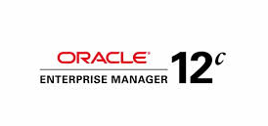
OEM 12c: A Single Pane of Glass Over Your Estate
Cloud Management
Capacity Planning
Infrastructure Management
Configuration Management
Provisioning and Patching
Application Quality Management
Database Management
Middleware Management
Application Management
Enterprise Reporting
SaaS
Deployed Applications
Application Framework
PaaS
Runtime
Web & Application Server
Database
Integration
Operating System
Compute
Storage
IaaS

Slide 33
Hybrid Cloud: Bringing It All Together

Slide 34
The Oracle Cloud

Slide 35
Cintra Can Help You Design and Deploy a Next-Gen Architecture

Slide 36
Do You Have a Roadmap To Your Cloud Architecture?
Let’s have a discussion…
info@cintra.com
Architecture | Legacy Capability | Modern Capability | HA | CONSOLIDATE | APPLIANCE | ORACLE VERSIONS | MANAGE | REPORT | SECURE | CLONE | OPTIMIZE LICENSE
User Experience | 4 | 8 |  |  | ü | ü | ü | ü
Job Performance | 4 | 9 |  |  | ü | ü | ü | ü
Availability | 4 | 9 | ü | ü | ü | ü | ü | ü | ü | ü
Data Protection | 2 | 8 | ü | ü | ü | ü | ü | ü | ü | ü
Time to Recover | 4 | 8 | ü | ü | ü | ü | ü | ü | ü | ü
Agility | 2 | 9 |  | ü | ü | ü | ü | ü |  | ü | ü
Scalability | 3 | 7 | ü | ü | ü | ü | ü | ü |  |  | ü
Security | 2 | 8 |  | ü |  | ü |  |  | ü
Simplicity | 4 | 8 | ü | ü | ü | ü |  | ü |  | ü
Data Management | 1 | 6 |  |  | ü | ü | ü | ü | ü
Productivity | 3 | 7 | ü | ü | ü | ü | ü | ü |  | ü
SW Compliance | 3 | 8 | ü | ü | ü | ü |  |  |  |  | ü
Business Value | 3 | 8 | ü | ü | ü | ü | ü | ü | ü | ü | ü

